Slide 1
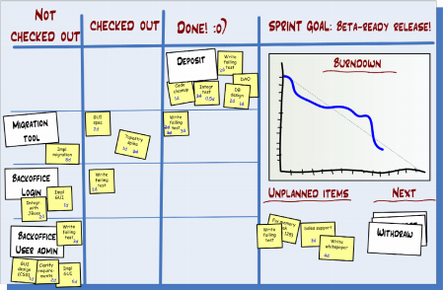
An Introduction to Scrum

Slide 2
What is Scrum?
Scrum:
Is an agile, lightweight process
Can manage and control software and product development
Uses iterative, incremental practices
Has a simple implementation
Increases productivity
Reduces time to benefits
Embraces adaptive, empirical systems development
Is not restricted to software development projects
Embraces the opposite of the waterfall approach…

Slide 3





Scrum
24 hours
Sprint
2-4 weeks
Sprint goal
Return
Sprint backlog
Potentially shippable
product increment
Return
Cancel
Gift wrap
Coupons
Gift wrap
Cancel
Coupons
Product
backlog

Slide 4







Scrum Roles
Product Owner
Possibly a Product Manager or Project Sponsor
Decides features, release date, prioritization, $$$
Scrum Master
Typically a Project Manager or Team Leader
Responsible for enacting Scrum values and practices
Remove impediments / politics, keeps everyone productive
Project Team
5-10 members; Teams are self-organizing
Cross-functional: QA, Programmers, UI Designers, etc.
Membership should change only between sprints

Slide 5
Product owner
Define the features of the product
Decide on release date and content
Be responsible for the profitability of the product (ROI)
Prioritize features according to market value
Adjust features and priority every iteration, as needed
Accept or reject work results

Slide 6
The ScrumMaster
Represents management to the project
Responsible for enacting Scrum values and practices
Removes impediments
Ensure that the team is fully functional and productive
Enable close cooperation across all roles and functions
Shield the team from external interferences

Slide 7
The team
Typically 5-9 people
Cross-functional:
Programmers, testers, user experience designers, etc.
Members should be full-time
May be exceptions (e.g., database administrator)

Slide 8
Sprints
Scrum projects make progress in a series of “sprints”
Analogous to Extreme Programming iterations
Typical duration is 2–4 weeks or a calendar month at most
A constant duration leads to a better rhythm
Product is designed, coded, and tested during the sprint

Slide 9
Sprint planning
Team selects items from the product backlog they can commit to completing
Sprint backlog is created
Tasks are identified and each is estimated (1-16 hours)
Collaboratively, not done alone by the ScrumMaster
High-level design is considered

Slide 10
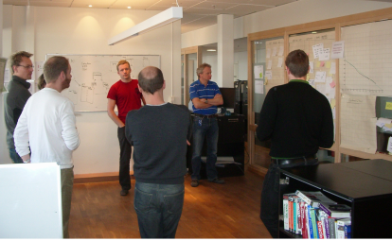
Daily Scrum Meeting
Parameters
Daily, ~15 minutes, Stand-up
Anyone late pays a $1 fee
Not for problem solving
Whole world is invited
Only team members, Scrum Master, product owner, can talk
Helps avoid other unnecessary meetings
Three questions answered by each team member:
What did you do yesterday?
What will you do today?
What obstacles are in your way?

Slide 11
Scrum's Artifacts
Scrum has remarkably few artifacts
Product Backlog
Sprint Backlog
Burndown Charts
Can be managed using just an Excel spreadsheet
More advanced / complicated tools exist:
Expensive
Web-based – no good for Scrum Master/project manager who travels
Still under development

Slide 12


Product Backlog
The requirements
A list of all desired work on project
Ideally expressed as a list of user stories along with "story points", such that each item has value to users or customers of the product
Prioritized by the product owner
Reprioritized at start of each sprint
This is the product backlog

Slide 13
User Stories
Instead of Use Cases, Agile project owners do "user stories"
Who (user role) – Is this a customer, employee, admin, etc.?
What (goal) – What functionality must be achieved/developed?
Why (reason) – Why does user want to accomplish this goal?
As a [user role], I want to [goal], so I can [reason].
Example:
"As a user, I want to log in, so I can access subscriber content."
story points: Rating of effort needed to implement this story
common scales: 1-10, shirt sizes (XS, S, M, L, XL), etc.

Slide 14
Sprint Backlog
Individuals sign up for work of their own choosing
Work is never assigned
Estimated work remaining is updated daily
Any team member can add, delete change sprint backlog
Work for the sprint emerges
If work is unclear, define a sprint backlog item with a larger amount of time and break it down later
Update work remaining as more becomes known

Slide 15
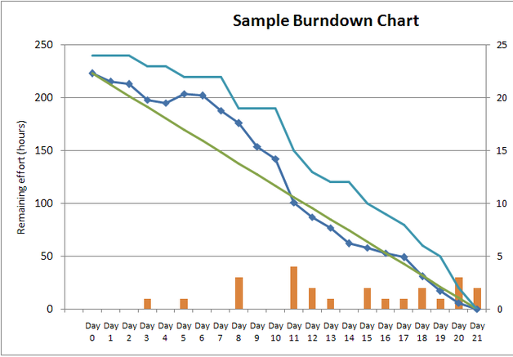
Sprint Burndown Chart
A display of what work has been completed and what is left to complete
one for each developer or work item
updated every day
(make best guess about hours/points completed each day)
variation: Release burndown chart
shows overall progress
updated at end of each sprint

Slide 16
The Sprint Review
Team presents what it accomplished during the sprint
Typically takes the form of a demo of new features or underlying architecture
Informal
2-hour prep time rule
No slides
Whole team participates
Invite the world

Slide 17
Scalability
Typical individual team is 7 ± 2 people
Scalability comes from teams of teams
Factors in scaling
Type of application
Team size
Team dispersion
Project duration
Scrum has been used on multiple 500+ person projects

Slide 18
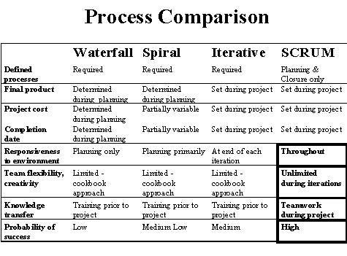
Scrum vs. Other Models

